Slide 1
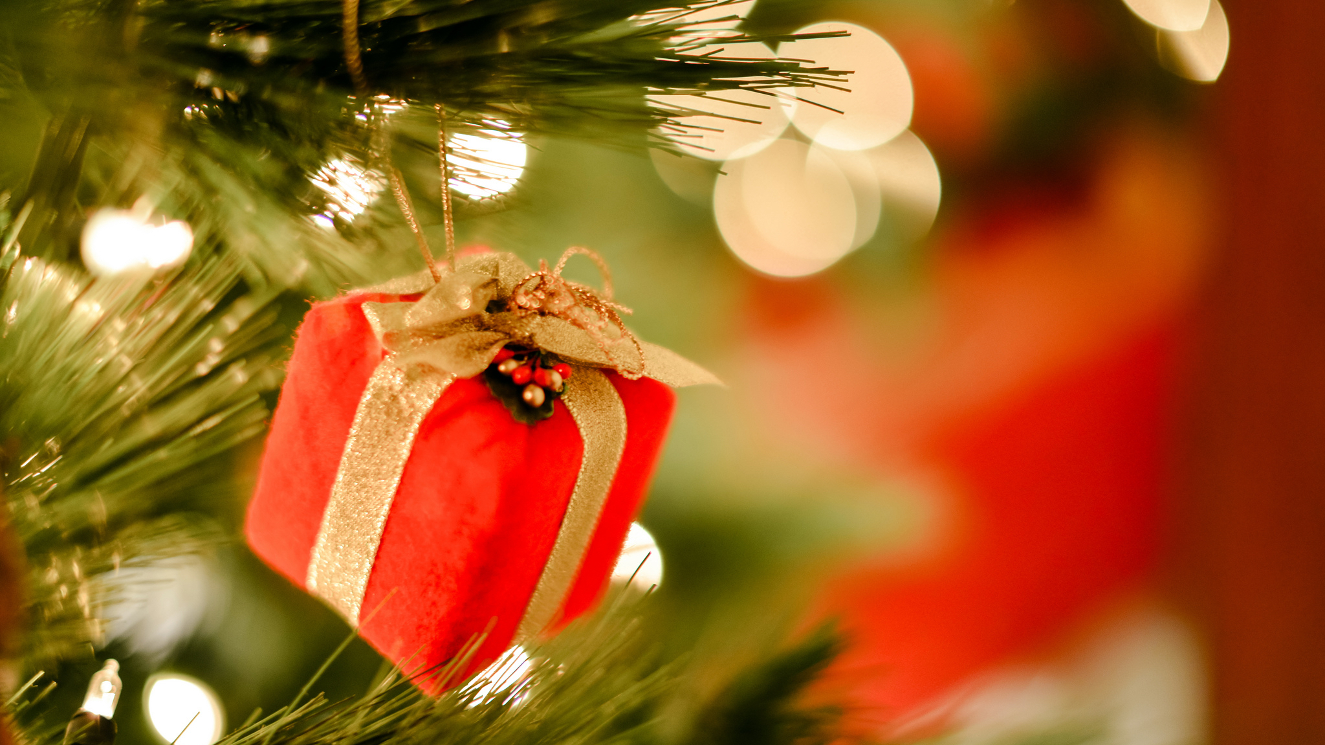
MERRY CHRISTMAS
Come join us for an open house Christmas gathering
December 16TH from
2-5 PM
12200 E. Iliff Ave, unit 107, Aurora CO 80014
(303)597-0038
This Photo by Unknown author is licensed under CC BY-NC.

